Slide 1

Customer Shopping Behavior Analysis
Uncovering insights from 3,900 purchases to guide strategic business decisions through data-driven analysis of spending patterns, customer segments, and product preferences.

Slide 2
DATASET OVERVIEW
Understanding Our Data Foundation
3,900
18
25
50
Total Purchases
Data Columns
Product Types
Locations
Transactions analyzed across all categories
Features tracking demographics and behavior
Items purchased across four categories
Geographic distribution of customers
Dataset captures customer demographics, purchase details, and shopping behavior including subscription status, discount usage, and review ratings with only 37 missing values.

Slide 3


PYTHON ANALYSIS
Data Preparation & Cleaning
01
Data Loading & Exploration
Imported dataset using pandas, examined structure with df.info() and summary statistics
02
Missing Data Handling
Imputed 37 missing Review Rating values using median rating per product category
03
Feature Engineering
Created age_group bins and purchase_frequency_days columns for deeper analysis
04
Database Integration
Connected to PostgreSQL and loaded cleaned data for SQL business analysis

Slide 4
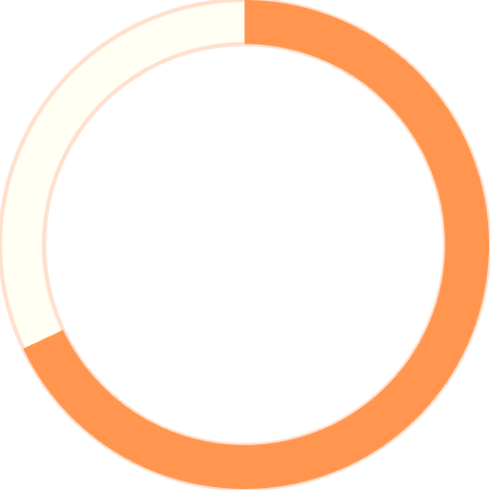
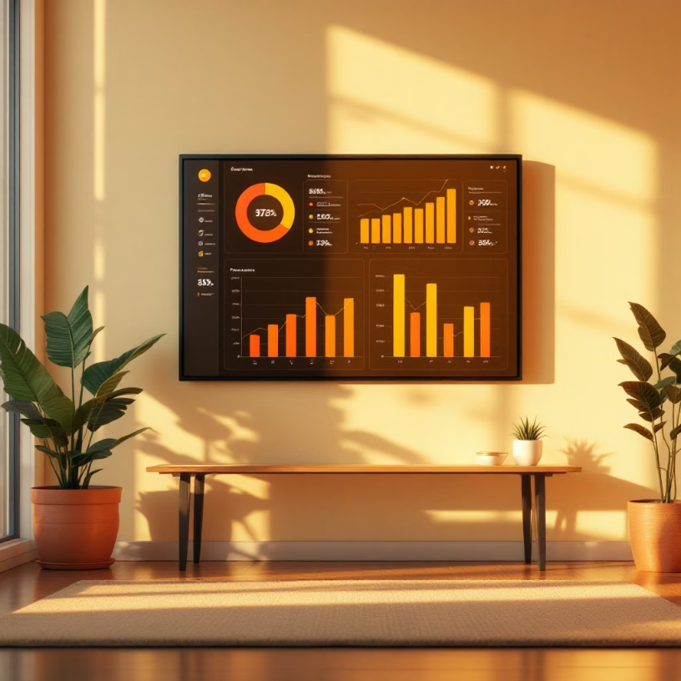
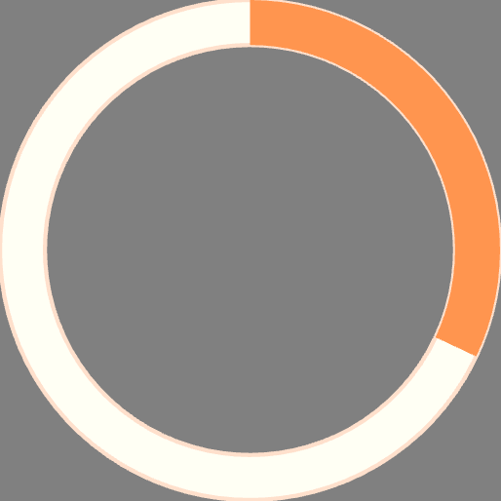
KEY INSIGHT
Gender Revenue Gap Revealed
68%
Male Revenue Share
$157,890 total revenue
32%
Female Revenue Share
$75,191 total revenue
Male customers generate more than double the revenue of female customers, presenting a significant opportunity for targeted marketing campaigns.

Slide 5




Smart Shoppers: Discount Users Who Spend Big
839 Customers
High-Value Segment
Used discounts but spent above average ($59.76)
Purchase amounts ranged from $62 to $97
Strategic Opportunity
Balance promotions with margin control

Slide 6


PRODUCT PERFORMANCE
Top-Rated Products & Shipping Insights
Highest Rated Items
Shipping Type Impact
3.86
Express Shipping
Gloves
$60.48 average purchase
3.84
Sandals
Standard Shipping
$58.46 average purchase
3.82
Boots
Express shipping customers spend 3.5% more on average, indicating higher-value customer segment willing to pay for convenience.

Slide 7


Subscription Status Analysis
Total Subscribers
Subscriber Spend
Non-Subscriber Spend
1,053
$59.49
$59.87
27% of customer base
Average purchase amount
Slightly higher average
Non-subscribers generate $170,436 total revenue versus $62,645 from subscribers, but represent untapped loyalty potential.

Slide 8






CUSTOMER SEGMENTATION
Understanding Customer Loyalty Levels
New (83)
Returning (701)
Loyal (3,116)
80% of customers are classified as Loyal based on purchase history, with 958 repeat buyers (>5 purchases) showing subscription interest. Focus loyalty programs on converting Returning customers.

Slide 9
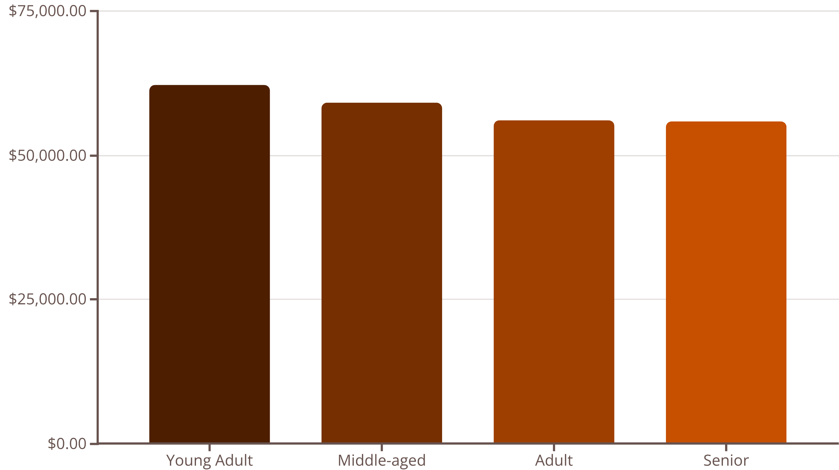
Revenue Distribution Insights
Young Adults lead revenue generation at $62,143, followed closely by Middle-aged customers. Clothing dominates sales across all categories, with Accessories and Footwear showing strong performance.

Slide 10




ACTION PLAN
Strategic Business Recommendations
Boost Subscriptions
Promote exclusive benefits to convert the 73% non-subscriber base into loyal subscribers
Customer Loyalty Programs
Reward repeat buyers to move 701 Returning customers into Loyal segment
Review Discount Policy
Balance sales boosts with margin control for 839 high-spending discount users
Targeted Marketing
Focus on Young Adults, express-shipping users, and top-rated products in campaigns

